Slide 1

AIR FRANCE
BUSINESS CASE
TEAM 4

Slide 2







BUSINESS SCENARIO
TEAM 4
Notes:
Tura

Slide 3


GOALS
KPI’s
ROA
ROI
Avg Cost per Click
Total Bookings
ROA
TEAM 4
Notes:
Tura

Slide 4
Publisher’s vs Kayak
USA
 | Overture | Yahoo | Google | MSN | Kayak
Clicks | 119,323 | 45,598 | 192,109 | 10,808 | 2,839
Bookings | 289 | 662 | 1550 | 140 | 208
Costs | $141,976 | $46,197 | $353,640 | $16,098 | $3,567
Profit | $205,457 | $836,091 | $1,391,841 | $165,451 | $230,126
TEAM 4
Notes:
vic

Slide 5

Publisher’s vs Kayak
 | Overture | Google | MSN | Kayak
Clicks | 119,323 | 192,109 | 10,808 | 2,839
Bookings | 372 | 797 | 129 | 208
Costs | $64,295 | $120,946 | $12,160 | $3,567
Profit | $365,788 | $808,603 | $133,363 | $230,126
TEAM 4
Notes:
vic

Slide 6

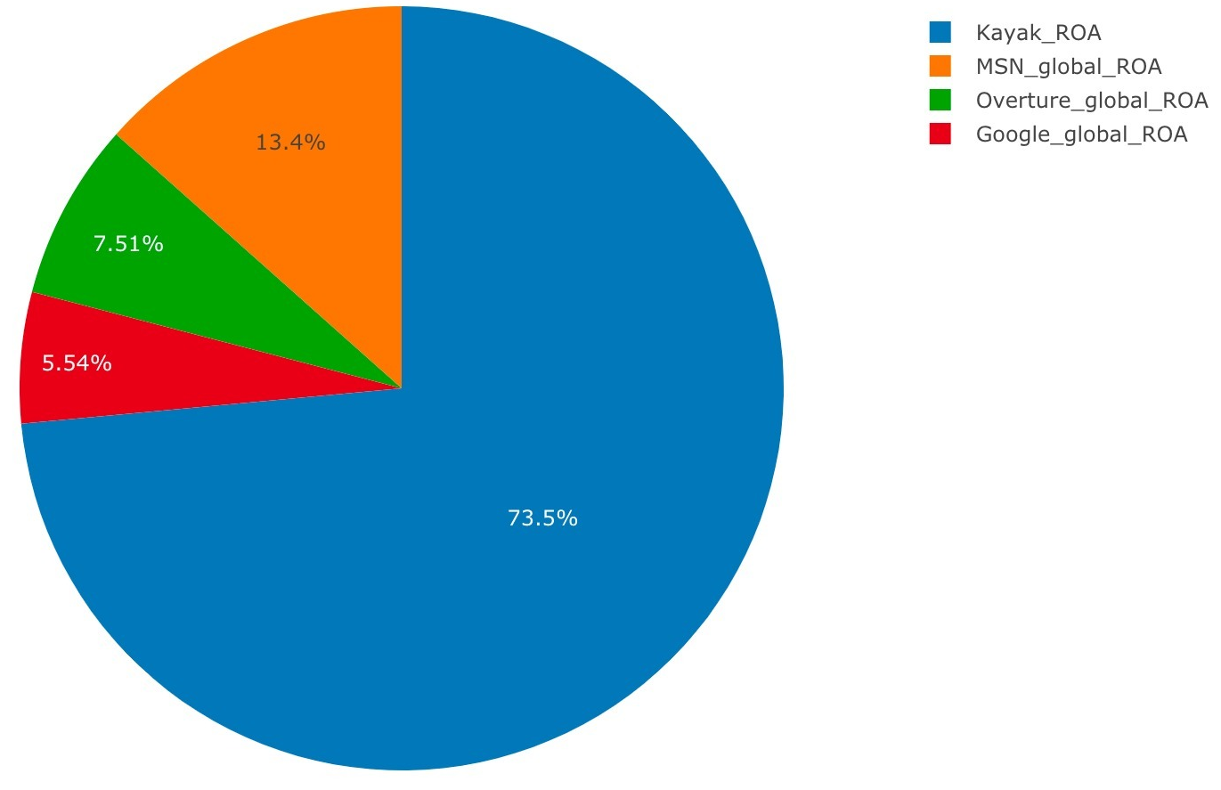
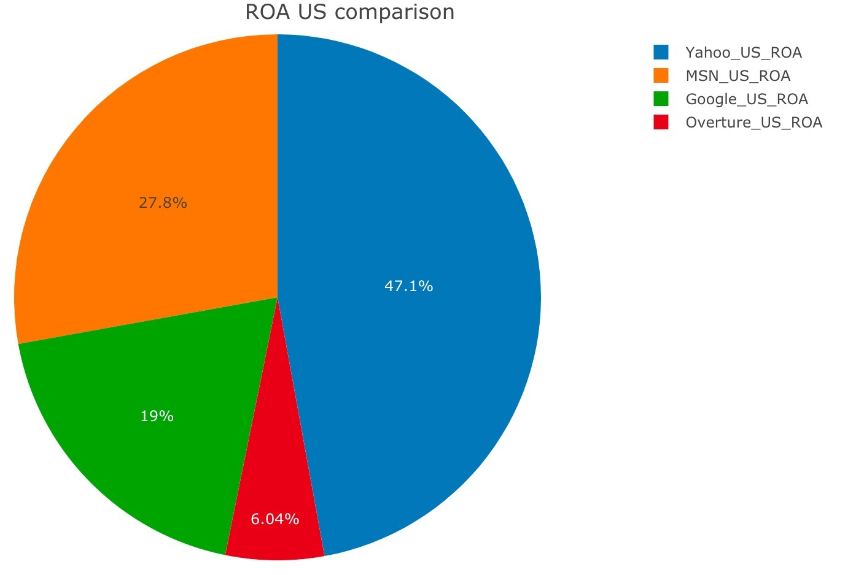
ROA Publishers & Kayak
USA
Notes:
vic

Slide 7

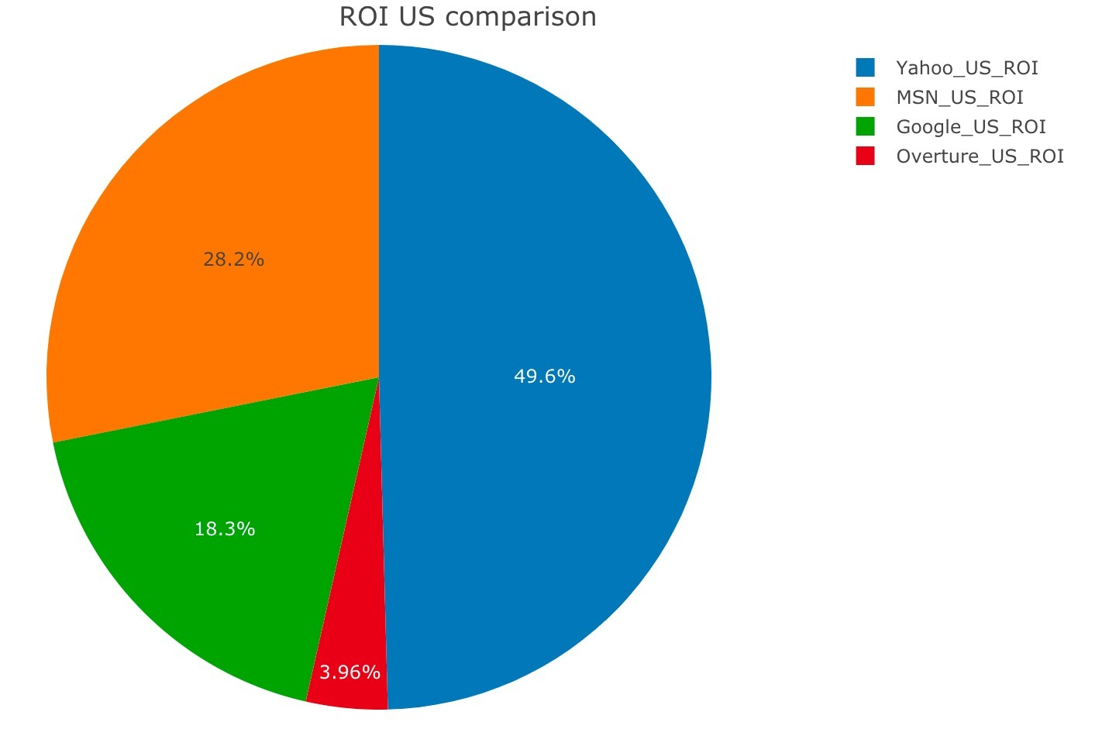
ROI Publishers & Kayak
USA
Notes:
Vic

Slide 8
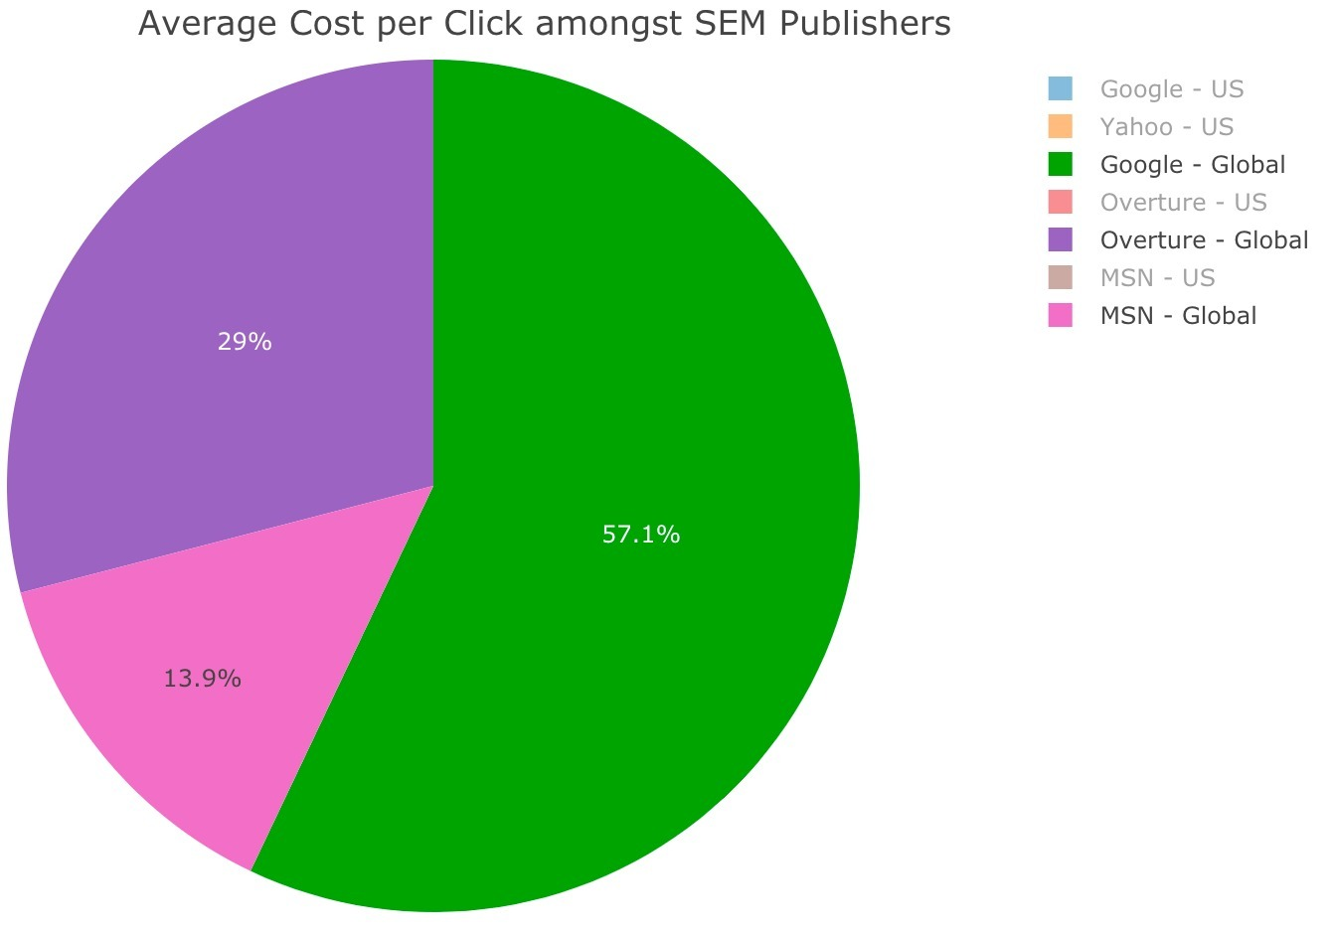
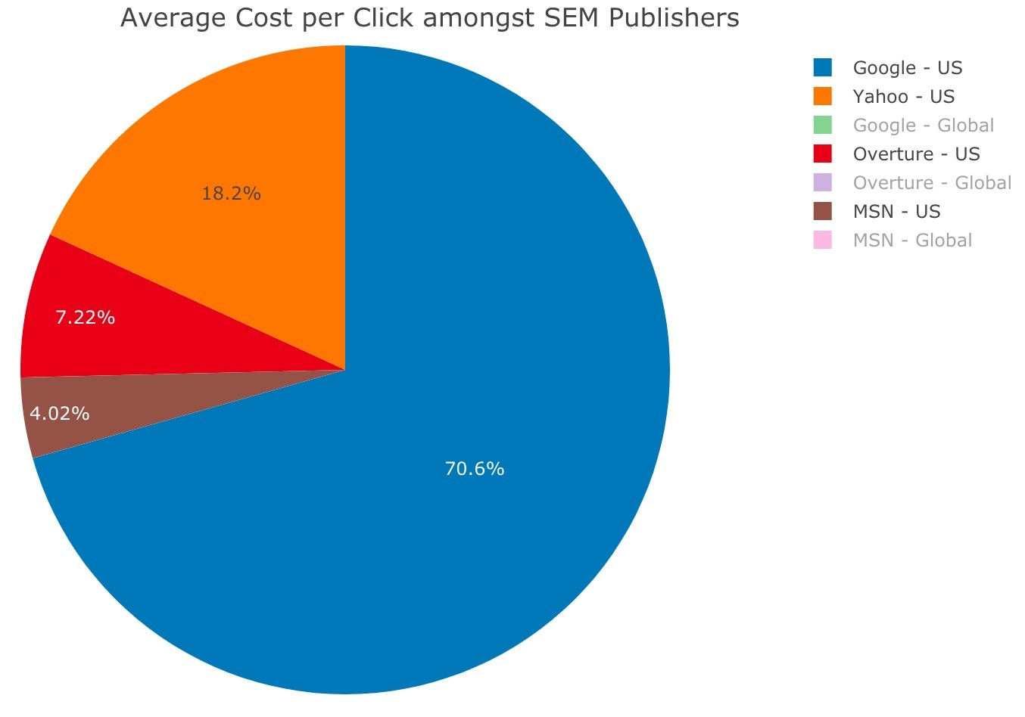
Global VS USA
Avg. Cost Per Click
USA
TEAM 4

Slide 9
Logistic Regression
Analyzing Profit
 | Estimate | Std. Error | P-value
Clicks | 4.257e-03 | 5.142e-04 | 2e-16 ***
Click_Charges | -7.104e-04 | 1.806e-04 | 8.37e-05 ***
Impressions | -7.786e-06 | 1.024e-06 | 2.81e-14 ***
TEAM 4

Slide 10
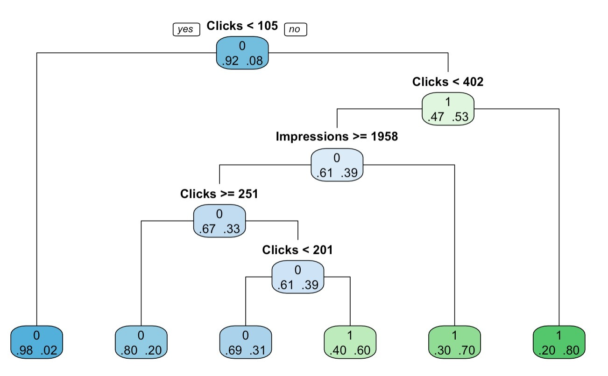
Decision Tree
Analyzing Profit
TEAM 4

Slide 11
Logistic Regression
Analyzing Bookings
 | Estimate | Std. Error | P-value
Clicks | 1.064e-02 | 1.111e-03 | 2e-16 ***
Click_Charges | -1.118e-03 | 4.216e-04 | 0.00801
Impressions | -4.519e-06 | 5.856e-07 | 1.2e-14
TEAM 4

Slide 12
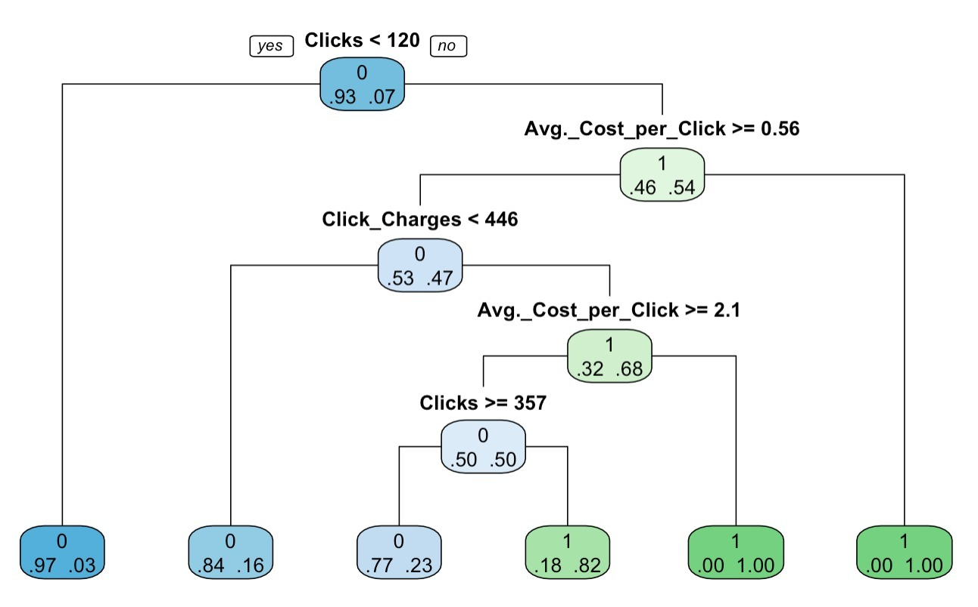
Decision Tree
Analyzing Bookings
TEAM 4

Slide 13
Final Recommendations
USA
TEAM 4

